Slide 1
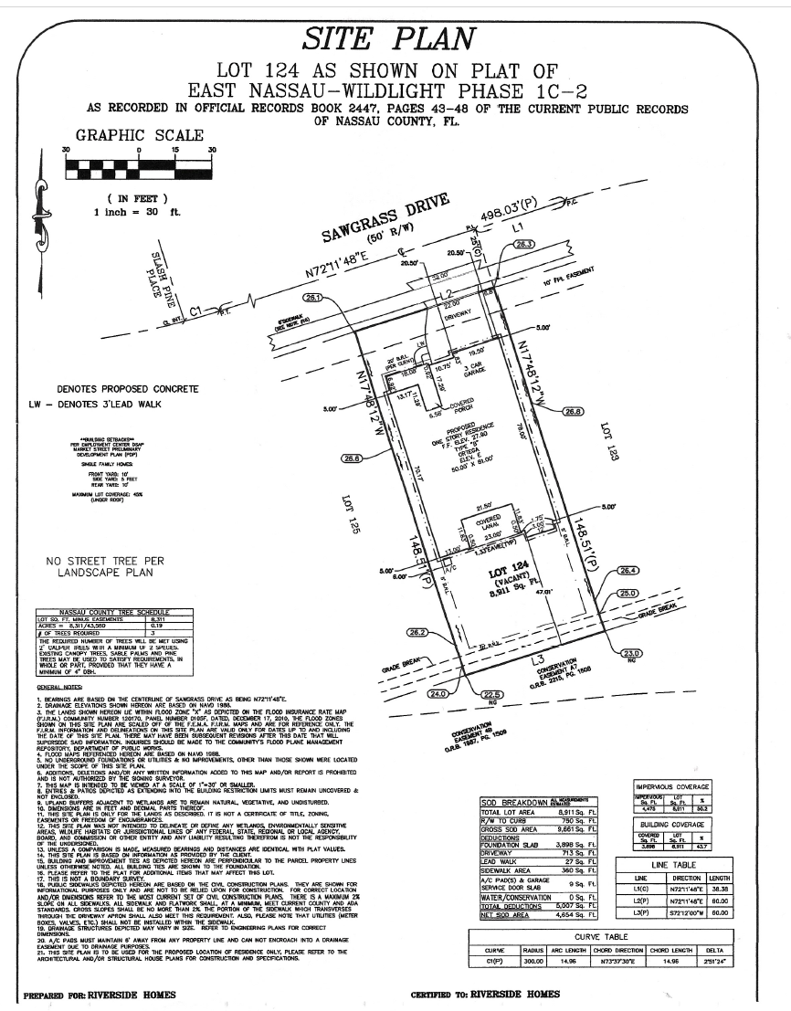
Data Masked
Attempt #3 DRC
- THIS IS MY LOT MAP. THERE ARE MANY LIKE IT BUT THIS ONE’S MINE. MY LOT MAP IS MY BEST FRIEND. IT IS MY LIFE. I MUST MASTER IT AS I MUST MASTER MY LIFE. WITHOUT ME, MY LOT MAP IS USELESS. WITHOUT MY LOT MAP I AM USELESS. I MUST USE MY LOT MAP TRUE. I MUST READ IT BETTER THAN MY HOA WHO IS TRYING TO FRUSTRATE ME. I MUST ENSURE IT IS READABLE SO MY HOA CANNOT FRUSTRATE ME. I WILL! BEFORE GOD, I SWEAR THIS CREED. MY LOT MAP AND MYSELF ARE CONTRIBUTORS TO OUR COMMUNITY. WE ARE THE MASTERS OF OUR NEIGHBORS BUSYBODY PHONE CALLS TO THE HOA. WE ARE THE SURVIVORS OF MY LIFE. SO BE IT, UNTIL THERE IS NO HOA TO FRUSTRATE ME, BUT PEACE. AMEN!
Data Masked

Slide 2
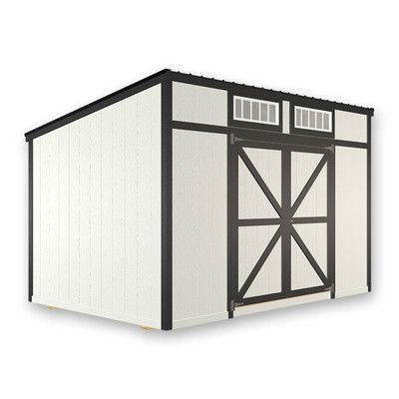
Data Masked
Data Masked
Window
Shed Style: Lean-to
Two door front entry - centered
Two windows on front – one each side of entry doors
One window on each side
Straight (closed) rear
Color Palette (matching primary residence)
Primary color - Blue
Trim – white
The reason this is positioned here is because the yard slopes severely and that is shown later in the slide deck (page) where the slope begins at around 31 foot from the residence and drops to a 33 degree drop/slope where you can’t build the shed. This is as far back as this can go

Slide 3
Permitter, Fence line
FRENCH DRAIN - This was installed by Riverside Homes in coordination with (whomever) – when they put in French drain. Next slide explains why this is there. The shed leverages the French drain for the DRAINAGE and that is shown on DRAINAGE MAP in a later slide (page)
Shed
10x14
Paver Patio
10x14
Privacy Wall are post and slats to hide the patio and shed
Privacy Wall
French Drain
Paver Patio
Distance from Residence to Shed is 22 feet
Paver Walk
A/C Handler
Residence
Patio Screen
Patio
Gate
Gate

Slide 4
Permitter, Fence line
Paver Patio
Paver Walk
←
2ft
→
Front of the 2-foot walk goes up the side of the house – ties into the front porch with pavers (same color as driveway).
Back of the 2-foot walk ties into the (shed patio) so it looks natural
Resident has gutters down both sides of the house. This Paver path sider – the gutters were tied into the French drain
The paver walk is exposed maybe 6 inches and that drainage runs off to the French drain
French Drain
This was installed by Riverside Homes in coordination with (whomever) when they put in French drain
You cannot walk between these house as it is complete MARSH
…And if you are disabled like the resident, you have slip and fall concerns. Resident need requirement:
No one asked or seems to care but here it goes: My knees are shot, three surgeries to date. After I got rattled when my armored vehicle was BLOWN UP in IRAQ – spinal damage does not help with balance. I can navigate it but as I get older – trying to do this tap dance over marsh land is not an easy task. The walkway is to have a dry path
A/C Handler
Residence
Patio Screen
Patio
Gate
Gate
French Drain
Entry
Part of residence
Front Porch

Slide 5
Plan provided signed by HOA-Resident-Masked – Home Owner
Data Masked - Signature

Slide 6
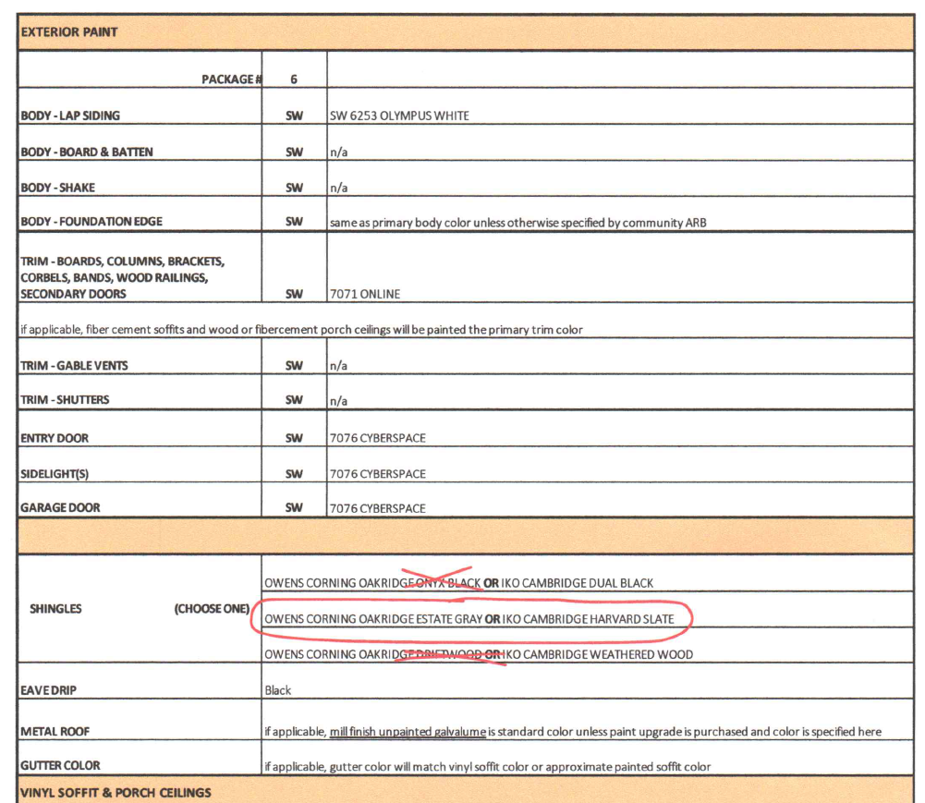
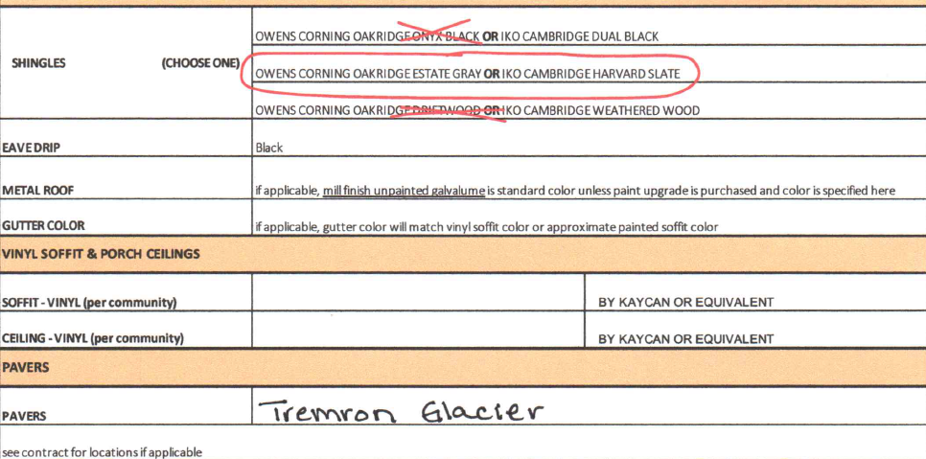
3. A material palette for the shed's siding, roof, and trim, along with details on the windows.
In accordance with the sales order and build / design of the primary residence with matching colors
Item | Color / Palette
Body | SW 6253 Olympus White
Foundation Edges | SW 6253 Olympus White
Guttering | White
Doors | 7076 Cyberspace
Pavers | Tremron Glacier
Trim | 7071 Online
Privacy Wall | Wood Stain Natural
Windows | White in color
Roof | Dual Black Cambridge
Item | Material Type
Body | 2x4 wood, Plyboard, Hardy Board to match design of primary residence
Foundation Edges | Wood Strips to match design of primary residence
Guttering | Aluminum to match design of primary residence
Doors | 2x4, Plyboard constructed (custom) to match design of primary residence
Pavers | Tremron Glacier to match design of primary residence
Trim | Wooden Trim Strips to match design of primary residence
Privacy Wall | Wood Stain Natural
Windows | Plastic (PVC) to match design of primary residence
Roof | Plyboard, Shingles to match design of primary residence

Slide 7
1. Complete drawings with full dimensions (height, width, depth), including window sizes and their dimensions. 2. A site plan showing the shed, hardscaping, and any other improvements, with measurements from the house and property lines. - Lines representative and not to scale / diagram provided for visual perspective - Scale represented by measurements
Front View
Overhang 1 foot
Overhang 1 foot
Roof Height: 4 inches
21 inch
16 inch
21 inch
27.5 inch
27.5 inch
Roof is sloped:
9 foot 4 inch front
8 foot 4 inch rear
25x26
25x26
Represents doorway and entrance for measurements
Represents doorway and entrance for measurements
18 inch
12 inch
18 inch
To Back Fence line
12 inch
To Primary Residence
84 inch
96.4 inch
Concrete Pad: 4 inches in height
Window Measurements

Slide 8
1. Complete drawings with full dimensions (height, width, depth), including window sizes and their dimensions. 2. A site plan showing the shed, hardscaping, and any other improvements, with measurements from the house and property lines. - Lines representative and not to scale / diagram provided for visual perspective - Scale represented by measurements
Side wall: Proximal to Primary Residence
Example Photo of Privacy Wall Style
To Fence line
Roof Line total length 12 foot / roof pitch is 7 degrees
Overhang 2 foot
9 foot 4 inch
Overhang 1 foot
Roof Height: 4 inches
Privacy Wall
16 inch
14 inch
8 foot 4 inch
6 Foot
Window
31.5x35
44.5 inch
44.5t inch
Approved Fenceline
44 inch
Front of building
Patio Area
Concrete Pad: 4 inches in height
4 inches
10ft
Length of Base = 10 foot
Distance: base to fence line: 5.5 foot

Slide 9
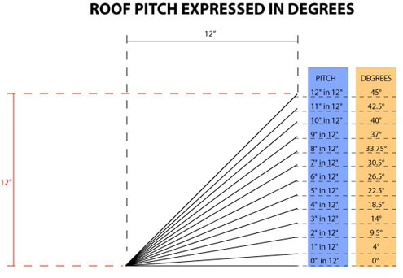
Side wall: Distal from Primary Residence
1. Complete drawings with full dimensions (height, width, depth), including window sizes and their dimensions. 2. A site plan showing the shed, hardscaping, and any other improvements, with measurements from the house and property lines. - Lines representative and not to scale / diagram provided for visual perspective - Scale represented by measurements
Roof Line total length 12 foot / roof pitch is 7 degrees
Overhang 2 foot
Overhang 1 Foot
Roof Height: 4 inches
16 inch
9 Foot 4 inch
14 inch
Front of Building
8 foot 4 inch
31.5x35
44.5 inch
44.5 inch
Approved Fenceline
44 inch
To Fence line
Concrete Pad: 4 inches in height
Patio Area
Distance: base to fence line: 5 ft
Length of Base
Measurements of Patio and Privacy Wall shown on Proximal Side Wall Diagram

Slide 10
1. Complete drawings with full dimensions (height, width, depth), including window sizes and their dimensions. 2. A site plan showing the shed, hardscaping, and any other improvements, with measurements from the house and property lines. 3. A material palette for the shed's siding, roof, and trim, along with details on the windows. - Lines representative and not to scale / diagram provided for visual perspective - Scale represented by measurements
Rear View
Roof Line total length 16 foot
Overhang 1 foot
Overhang 1 foot
Roof Height = 4 inches
8 foot 4 inch
To Primary Residence
To Back Fence line
Concrete Pad: 4 inches in height
Length of Base 14 foot

Slide 11
1. Complete drawings with full dimensions (height, width, depth), including window sizes and their dimensions. 2. A site plan showing the shed, hardscaping, and any other improvements, with measurements from the house and property lines. 3. A material palette for the shed's siding, roof, and trim, along with details on the windows. - Lines representative and not to scale / diagram provided for visual perspective - Scale represented by measurements
Top View Building: Paver Patio Pad
To Back Fence line
5.5 Ft
3 Ft
27 Ft
1.5 Ft
Shed
Path Area
2 Ft
10 Ft
10ft
16ft
1.5 Ft
Residence
5ft from shed to severe grading slope
14 ft
Patio Area
2 ft
10 Ft
8 Ft
Patio
Privacy Wall – 6ft height, 4 inch depth
4x4 inch (posts)
14 Ft
17 ft
Grading is severe slope at 5Ft at an almost 33 degree hill – goes 12 Ft to the rear lot (Fence)
Grading begins to slop down here where 2ft of the shed and patio are built up (graded) to be level. This is an approximate 7 degree slope (1.5 inches build (pavers sit higher) to level the patio area

Slide 12
Permitter, Fence line
8. A grading and drainage plan detailing how stormwater will be managed on the site, particularly runoff from the shed roof and walkways.
French Drain (Buried)
Between these two points is severe decline/grading at 33 degree slope over 12 FT distance
CURRENT STATE
Top View Landscape
Mild slop at 7 degree – 5FT
Orange Arrows show current draining direction
A/C Handler
Patio
Residence

Slide 13
Permitter, Fence line
8. A grading and drainage plan detailing how stormwater will be managed on the site, particularly runoff from the shed roof and walkways.
French Drain (Buried)
Between these two points is severe decline/grading at 45 degree slope over 12 FT distance
FUTURE STATE
Top View Landscape
Mild slop at 8 degree – 5FT
Shed has guttering to direct water to the designed ground slope (next slide: Future State Side View) which is the current direction of drainage from the flat existing landscape prior to the slope down
Pavers are porous to allow drainage like existing ground (not cement)
Runoff water is directed into the rock buried French drain installed by the Builder January 2025
Paver Walk is 2 feet in width centered with 1.5 foot of original landscape on each side
Paver Patio
10x14
Shed
10x14
Privacy Wall
Paver walk
Paver Walk
Ft Inches
Orange Arrows show draining direction
A/C Handler
Patio
Residence

Slide 14
Permitter, Fence line
8. A grading and drainage plan detailing how stormwater will be managed on the site, particularly runoff from the shed roof and walkways.
CURRENT STATE
Side View Landscape
Residence
Grade Break shown later for Lot MASKED Map
Grading for shown slope begins for 5 feet at a 7-degree slope and then drops off for 12 feet of a 33-degree slope
31 Foot
Patio
A/C Handler
17 Foot
French Drain (buried)

Slide 15
Permitter, Fence line
8. A grading and drainage plan detailing how stormwater will be managed on the site, particularly runoff from the shed roof and walkways.
FUTURE STATE
Side View Landscape
Residence
Grade Break shown later for Lot Masked Map
Grading for shown slope begins for 5 feet at a 7-degree slope and then drops off for 12 feet of a 33-degree slope
17 foot
14 Foot
Patio
Shed
10x14
A/C Handler
5 foot
12 Foot
Concrete Pad: 4 inches in height
French Drain (buried)
Shed has guttering to direct water to the slope which is the current direction of drainage from the flat section of landscape
Pavers are porous to allow drainage with existing ground (not cement)
Runoff water is directed into the rock buried French drain

Slide 16
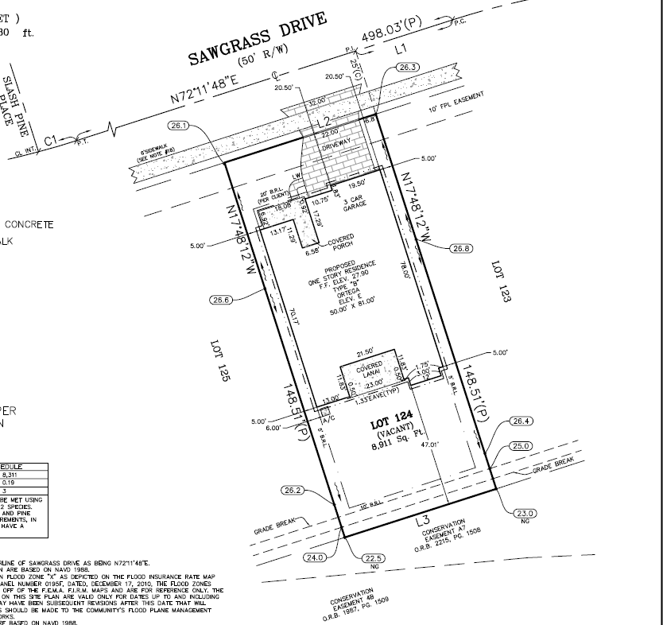
Data Masked
CURRENT STATE
Top View Landscape
Data Masked

Slide 17
Data Masked
FUTURE STATE
Top View Landscape
Data Masked
Color Designates Shed Legend Item
Color Designates Patio Legend Item
SLOPE BEGINS HERE AT THIS RED LINE at approximately 33 degree drop
Grade Break shown later for MASKED Map
Grading for shown slope is between 30 and 35 degree represented in a different illustration
Shed does change original drainage direction with exception the roof collects draining to gutters to return any drainage to the original path and over new installed developer French drain system
Roof is a 7-degree slope from front of shed to rear of shed. Design of this roof shown in other illustrations provided
SLOPE distance start is at 5 foot from shed wall furthest from primary residence

Slide 18
Attempt #3 DRC
- THIS IS MY LOT MAP. THERE ARE MANY LIKE IT BUT THIS ONE’S MINE. MY LOT MAP IS MY BEST FRIEND. IT IS MY LIFE. I MUST MASTER IT AS I MUST MASTER MY LIFE. WITHOUT ME, MY LOT MAP IS USELESS. WITHOUT MY LOT MAP I AM USELESS. I MUST USE MY LOT MAP TRUE. I MUST READ IT BETTER THAN MY HOA WHO IS TRYING TO FRUSTRATE ME. I MUST ENSURE IT IS READABLE SO MY HOA CANNOT FRUSTRATE ME. I WILL! BEFORE GOD, I SWEAR THIS CREED. MY LOT MAP AND MYSELF ARE CONTRIBUTORS TO OUR COMMUNITY. WE ARE THE MASTERS OF OUR NEIGHBORS BUSYBODY PHONE CALLS TO THE HOA. WE ARE THE SURVIVORS OF MY LIFE. SO BE IT, UNTIL THERE IS NO HOA TO FRUSTRATE ME, BUT PEACE. AMEN!

Slide 19
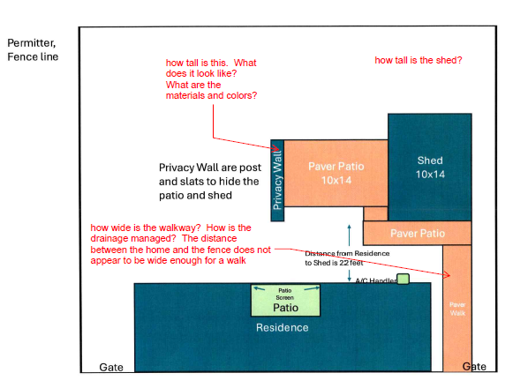
History of events
December 9, 2024: Approximate visit by MASKED HOA manager and employee to advise on a “trashcan run” approved solution whereas the adjacent neighbor had “concerns” to address. Concerns included
Encroachment: identified as true – resident correcting
Directions that the resident “move the gate to opposite side of the yard” – resident declined – this gate was in an approved solution and the adjacent neighbor does not have any requirement this gate cannot be in this location
Direction that the resident “not walk or touch the neighbor's grass” – resident will abide
Identified in discussion that the resident desired a shed and was informed “we are not concerned with the backyard in as much that it cannot be seen from the street, but if you have questions on this you can submit a Design Review Committee (DRC) applications”
January 29, 2025: Submission of the DRC application to the MASKED HOA management company employee in response to MASKED HOA management company employee email stating “We wanted to reach out because we noticed you are building what appears to be a shed or storage of some sort in the backyard. Because this can be seen from a common area/road, please submit a DRC application for approval prior to completing construction. Also, please attach a Lot Survey and any additional, helpful information such as color, style, etc. I have also attached the design guidelines outlining ancillary structures (Page 2: D-9). ”
February 11, 2029: MASKED Resident inquired on the DRC response
February 13, 2025: MASKED HOA management company employee responded they would follow up
February 20, 2023: MASKED HOA management company employee email: “Attached is the drawing of your project that was included in your application. The Town Architect has added some additional questions. Please respond to these and email them back to me so I can forward them to the Town Architect.”
Jonesgr “how tall is the shed?
Jonesgr “how tall is this. What does it look like? What are the material and colors? (reference – this is from a PDF with arrow pointing at privacy wall
Jonesgr “how wide is the walkway? How is the drainage managed? The distance between the home and the fence does not appear to be wide enough for a walk” (reference: this is pointing at a paver walk on the side of the home/unit)

Slide 20
History of events (continued)
February 20, 2023: Resident response by email:
Extracted the questions in the diagram
Series of questions: Pointing at privacy wall
Q: How tall is this?
Q: What does this look like?
Q: What are the materials and colors?
How tall is the shed?
Series of question for walk path
How wide is the walkway?
How is drainage managed?
The distance between the home and the fence does not appear to be wide enough for a walk?
Answers:
Series of questions: Pointing at privacy wall
Q: How tall is this? Privacy wall is 8 feet
Q: What does this look like? Attached a picture that is similar to the design – alternating slats
Q: What are the materials and colors? Colors will be wood stain – or whatever HOA advises. I can make it same color as primary residence (gray) similar to the house hardy board colors if desired. Did not finalize color and thought wood stain would be acceptable
Intent: as the shed and paver section faces the side street, the privacy wall is to better “hide” the structure and patio to retain privacy.
Secondary Intent: The privacy wall is intended to be cosmetically pleasing to the road side view and we may have some foliage (flowers) and such aligned to the slats (flower boxes). This is why we have slats. To break up the scenery with something of design (art)
How tall is the shed? 8.5 foot, doorway is standard height
Not asked but to inform: The shed matches the design of the house. Hardy board, same color scheme.
Intent: this is to match and seem like a natural extension of the primary residence
Image provided by Resident for visual example of privacy wall intended

Slide 21
Added on 3/01/2025 in response to HOA questions
Complete drawings with full dimensions (height, width, depth), including window sizes and their dimensions.
2. A site plan showing the shed, hardscaping, and any other improvements, with measurements from the house and property lines.
3. A material palette for the shed's siding, roof, and trim, along with details on the windows.
4. A color palette for all improvements, including the shed body, trim, roof, and pavers.
5. Evidence of a Nassau County building/zoning permit, if required. - NONE REQUIRED per Florida Building code section 102.2.5 - https://www.nassaucountyfl.com/DocumentCenter/View/3488/Tab-K-Ordinance-re-Permitting-and-Code-Requiremen?bidId=
Shed is under the 250 sq foot
6. If outdoor lighting is proposed, please provide the fixture type and location. - NONE PLANNED
7. If landscaping is proposed, please provide a landscape plan with plant sizes, species, and locations. - NONE PLANNED
8. A grading and drainage plan detailing how stormwater will be managed on the site, particularly runoff from the shed roof and walkways.
Shed uses existing draining by directing the water to the rear and gutter to the slope that exists
Gutter /draining over a Developer installed French drain system (at rear wall of shed) due to the excessive moisture between the two properties – this shed location takes advantage of this location with gutters to move water to the natural (and current) draining paths. Water traverses a 5-foot section of ground (direction from gutter exit) to leverage the French drain path.
Pavers allow for normal seepage as exiting grounds, flow of water across pavers not changing any drainage direction of path
Shed base is on level ground for 5 foot before a significant slope/break that is about 40 degrees (for 12 Ft)
Illustration provided later in this slide deck to assist with context to these statements

Slide 22
Added on 4/20/2025 in response to HOA deny reasons
DRC – 1C2-163—340 HOA-Resident-Masked Drive—Shed Project
After careful review, the application is denied. This decision is based on the following factors:
Location and Drainage: The proposed location of the shed raises concerns regarding potential drainage impact on adjacent properties due to the increased impervious surface area. The Residential Design Guidelines regarding Ancillary Structures states that “Structures should not negatively affect neighboring lots.”
Compliance with Residential Design Guidelines: The Residential Design Guidelines stipulate that ancillary structures should be situated at the “rear of the property and effectively screened from public view” and neighboring homes. The current location does not align with this guideline.
Property Line Setback: There is a lack of clarity regarding the shed's precise location relative to the side property line. The initial application indicated a 3.5-foot setback, which does not meet the required minimum of 5 feet. While the subsequent application indicates a revised 5-foot setback, it remains unclear whether the structure was relocated or if the initial measurement was inaccurate.
Privacy Wall: The proposed height of the privacy wall is 8 feet; however, the Residential Design Guidelines for Fences and Walls specify that privacy fences/walls are not to exceed 6 feet. Additionally, the Yard Features portion of the Residential Design Guidelines state that yard features, such as sheds, should be properly screened with landscaping
should you choose to submit a revised application, it must at a minimum include the following:
A site plan depicting the proposed shed situated at the rear of the property out of public view, with a minimum setback of 5 feet from the property line; and
A drainage plan to address the impact of the increased impervious surface area.

Slide 23
Added on 4/20/2025 in response to HOA deny reasons Response: Deny Reason #1
DRC – 1C2-163—340 HOA-Resident-Masked Drive—Shed Project
After careful review, the application is denied. This decision is based on the following factors:
Location and Drainage: The proposed location of the shed raises concerns regarding potential drainage impact on adjacent properties due to the increased impervious surface area. The Residential Design Guidelines regarding Ancillary Structures states that “Structures should not negatively affect neighboring lots.”
Within the original package – there were answers to these concerns – based on this current package / submission I will try to guide the evaluator where these answers exists
Current Slide 19 and 20 : Shows original flow of water and how the shed would cause any redirect
Current slide 23 and 24: Drainage map: This reflects the following features
French drain: this is directly behind this shed - leveraged
Guttering: that guttering on rear of shed directs any water collected to the rear of the property and over this French drain
Unfortunate reality: per verbal discussion with HOA management and employee – we had built the baseline structure (4 walls and a roof) which was in position from Mid January until April 18, 2025. As the HOA visit may be considered a “misspoken” set of guidance -- we built this shed until we were directed to take it down as per the second deny from DRC (this could be the third deny, it is not clear to me). I’ve asked but the answers are obfuscated on every questions. So, anyway, the unfortunate reality is – we built the stupid thing and if there were any rain or water concerns – they were actually tested/validated as no impact to the neighbor at that time. This is also without the structure having gutters. Neighbor liked it so much; he asked the guy helping me what it would take for him to build a shed like mine. As this is a very “interpretable” guidance statement for deny – I can get a letter from my neighbor if the HOA wants to go that far on this concern.
If drainage map explanation are insufficient – that was directly asked of the HOA management company by email to clarify that so I can get whatever is acceptable for submission

Slide 24
Added on 4/20/2025 in response to HOA deny reasons Response: Deny Reason #2
DRC – 1C2-163—340 HOA-Resident-Masked Drive—Shed Project
After careful review, the application is denied. This decision is based on the following factors:
Compliance with Residential Design Guidelines: The Residential Design Guidelines stipulate that ancillary structures should be situated at the “rear of the property and effectively screened from public view” and neighboring homes. The current location does not align with this guideline.
Within the original package – there were answers to these concerns – based on this current package / submission I will try to guide the evaluator where these answers exists
Shown on Slides 21 and 22 – SLOPE concerns
Unfortunate reality: because there is a 33 degree drop off slope, the furthest to the rear of the property a shed could go is the current target location. Otherwise, there would be requirements to build a cement block retaining wall that would be unsightly to create a level space. Additionally, the shed was target to this side of the yard to handle any drainage concerns due to the French drain existing on that side of the yard.

Slide 25
Added on 4/20/2025 in response to HOA deny reasons Response: Deny Reason #3
DRC – 1C2-163—340 HOA-Resident-Masked Drive—Shed Project
After careful review, the application is denied. This decision is based on the following factors:
Property Line Setback: There is a lack of clarity regarding the shed's precise location relative to the side property line. The initial application indicated a 3.5-foot setback, which does not meet the required minimum of 5 feet. While the subsequent application indicates a revised 5-foot setback, it remains unclear whether the structure was relocated or if the initial measurement was inaccurate.
Within the original package – there were answers to these concerns – based on this current package / submission I will try to guide the evaluator where these answers exists
This packed was updated and sent with a statement by email to the HOA-Management-Employee that it submission was updated to be compliant with Easement. I am uncertain what else to do other than state I noticed during the exemption to permit that the easement was 5 foot and intended to have the shed at 5.5 ft.
Communications: I am not sure what to do with this “confusion” concern “Slight adjustments on the package for the measurements from property edge (5”BRL required) …”
I am frustrated this is even in the deny of previous attempt because a simple communication (call, email) could have solved this one
EMAIL Copied here: March 12, 2025: HOA Resident to HOA-Management-Company-Employee
From: MASKED-Resident@outlook.com>
Sent: Wednesday, March 12, 2025 8:24 PM To: MASKED HOA Management Employee@ccmcnet.com>;
Subject: RE: MASKED-Community-Name DRC Application- Shed and Patio Project
MASKED HOA Management Employee
Slight adjustments on the package for the measurements from property edge (5”BRL required) and one comment in the response questions (when reading it over) was a big confusing – so I updated that to have more clarity (slide 5 bullet changed)
Shed base is on level ground for 5 foot before a significant slope/break that is about 40 degrees (for 12 Ft)
We will get the permit this week and forward that as soon as we have what is required

Slide 26
Added on 4/20/2025 in response to HOA deny reasons Response: Deny Reason #4
DRC – 1C2-163—340 HOA-Resident-Masked Drive—Shed Project
After careful review, the application is denied. This decision is based on the following factors:
Privacy Wall: The proposed height of the privacy wall is 8 feet; however, the Residential Design Guidelines for Fences and Walls specify that privacy fences/walls are not to exceed 6 feet. Additionally, the Yard Features portion of the Residential Design Guidelines state that yard features, such as sheds, should be properly screened with landscaping
Not sure what to do with this: This is a no brainer- fine, It will be 6 foot in height. I will update the plan with that number
Alternatively, HOA-Management-Employee recommend maybe the use hedges instead.
Someone tell me what can go here, and I will do that. The intent of this is to not have this area be “visible” to the neighbor or anyone down the street and that can be solved in 3 minutes on a phone call. I am not an expert on all the rules that this HOA put in place so somebody take a couple minutes and throw me a lifeline or something?

